Slide 1
Nifty Node Network
Rushad Antia

Slide 2
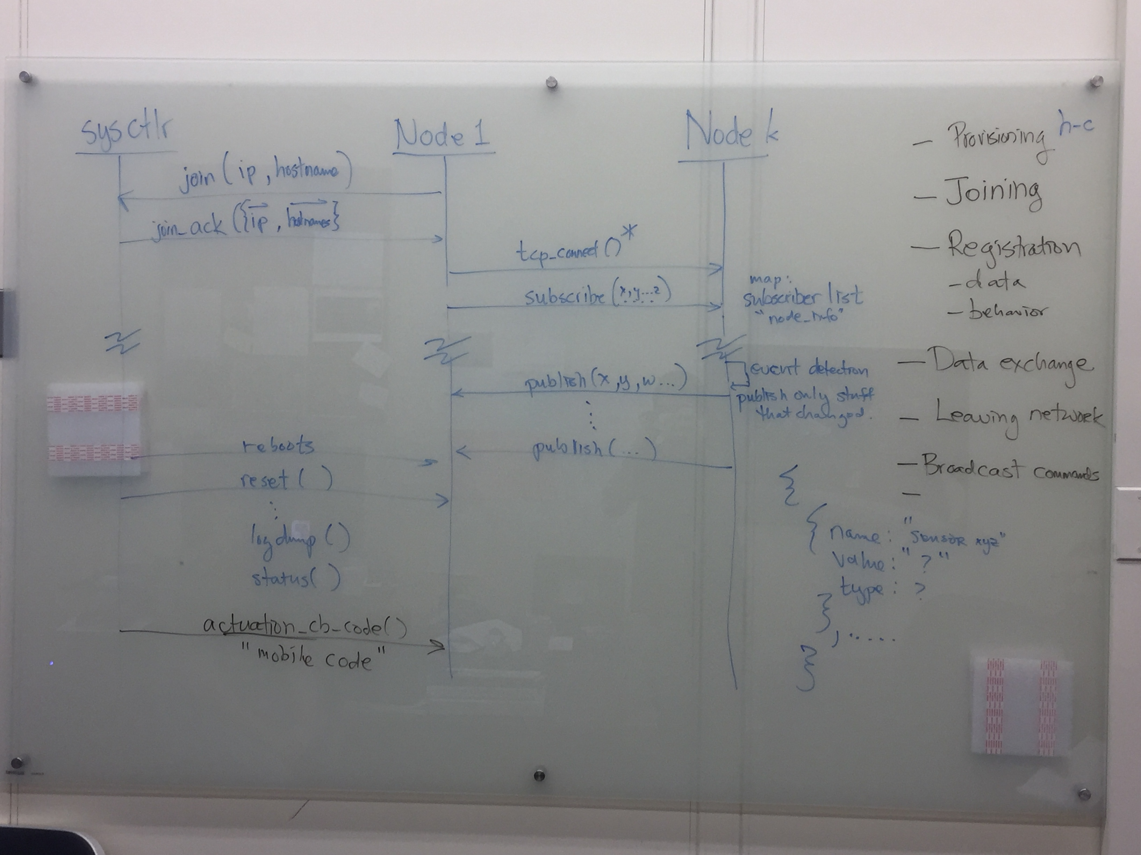

Slide 3
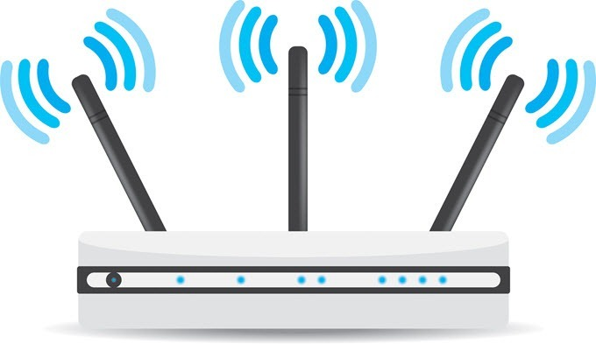
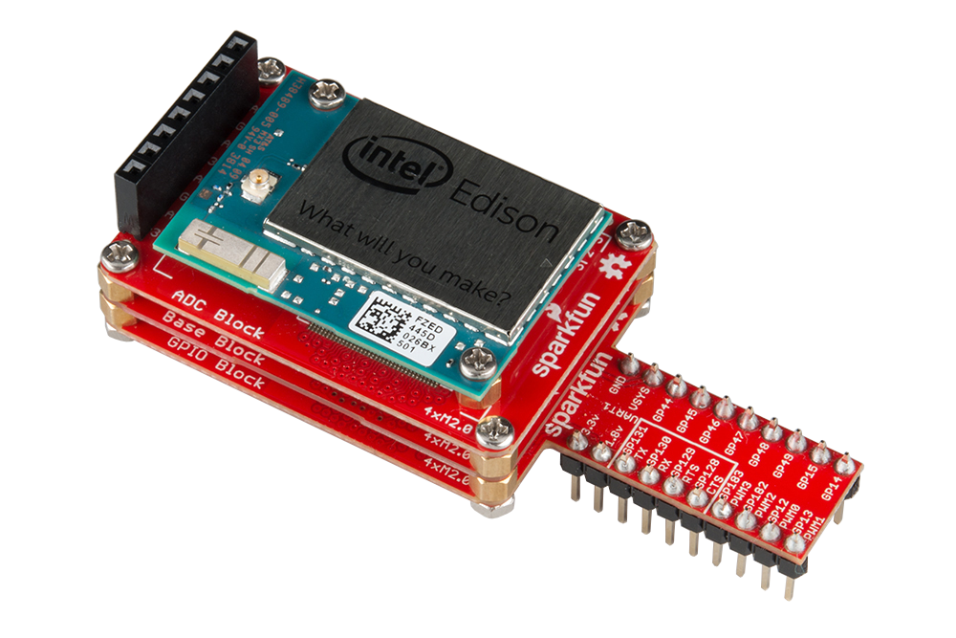

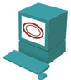
“Master Node”
Used for discovery of nodes on the network
Runs server at static ip
Nodes connect and exchange information (hostname, ip, sensors)
Holds table of connected devices
Ability to reboot, reset, and upload code to nodes
Node requests information about the network
MN responds by sending a list of connected devices to that node
edison01
10.20.0.10
temp
RJ-45
edison02
10.20.0.11
humidity
Node Table:
edison01:10.20.0.10:temp
edison02:10.20.0.11:humidity
edison03:10.20.0.12:light
edison03
10.20.0.12
light

Slide 4

Slave Node (Provisioning)
Creates object to connect to the Master Node
User inputs list of sensors that the node has
User starts the master node connection

Slide 5

Slave Node (joining) old
Give me connected node info!!
Here you go
Connects to master node
Requests other connected nodes information
Sees which nodes has what it wants
Makes connections to the nodes that have what it wants
Hmm…who has a light sensor?
I do!!!
Me too!!!
Lets get to know each other

Slide 6
Slave Node (joining) new
Edison02
Has: Light
Wants: Button
Here are devices you should connect to
Node connects to master node
Master node sees what the new node has/wants
Sends info of new devices to other devices based on what the new one has
Before
Edison05
Has:
Wants: Button, Light
Edison01
Has:
Wants: Button, Light
Edison03
Has: Button
Wants: Light
Edison04
Has:
Wants: Button, Light
Edison06
Has:
Wants: Button, Light

Slide 7
After Edison02 Joins
Edison03
Has: Button
Wants: Light
Edison02
Has: Light
Wants: Button
Edison01
Has:
Wants: Button, Light
Edison05
Has:
Wants: Button, Light
Edison06
Has:
Wants: Button, Light
Edison04
Has:
Wants: Button, Light

Slide 8
Problems
Intel XDK has tons of bugs in it

Slide 9
For the future
Make a website where you can monitor the nodes
Mobile code for custom actuation
Some way to auto reconnect
Some way to announce a disconnect from the network

